Slide 1
All microbes on a flash drive (work in progress)
Karel Břinda Joint work with Simone Pignotti, Kamil Salikhov, Rayan Chikhi, Zamin Iqbal, Gregory Kucherov, Michael Baym
DSB 2021

Slide 2
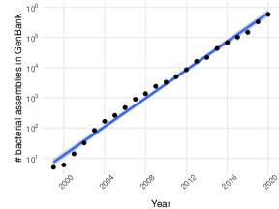
Introduction
Huge interest in genome collections
Instrumental to many biological discoveries; for instance, genome editing tools
Due to the exponential growth of data – compressing and indexing becomes hard
# bacterial assemblies in GenBank
(log scale)
Year

Slide 3
An example – the complete microbial corpus
Downloaded 450,000 microbial samples from ENA/SRA (reads & assemblies)
Constructed cleaned de Bruijn graphs
Indexed them using the BIGSI data structure
Provided the de Bruijn graphs on http://ftp.ebi.ac.uk/pub/software/bigsi/nat_biotech_2018/ctx/
12 TB of binary data after cleaning

Slide 4
Could we compress the entire microbial corpus so that everyone could use it?

Slide 5
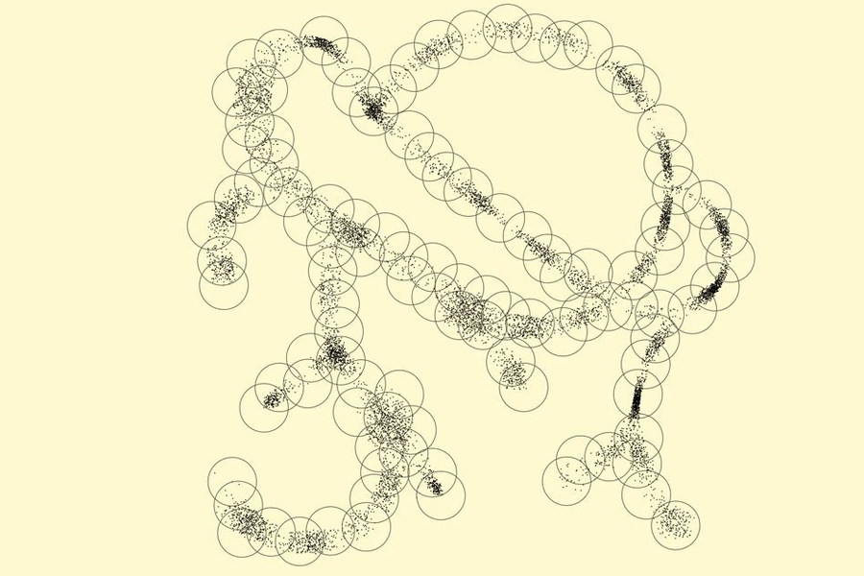
Compressive genomics
Algorithms that compute directly on compressed genomic data allow analyses to keep pace with data generation.
[Loh, Baym, Berger, Nat Biotech, 2012]

Slide 6
Trick 1: Biology provides priors on the data geometry

Slide 7
The geometrical structure of microbial data is known
Microbial samples form distinct clusters corresponding to species [Jain, Rodrigez, Phillippy & al., Nat. Com., 2018]
Genomes databases (e.g., RefSeq) provide a prior on these clusters
The clusters can be identified using metagenomic classification
The obtained clusters could be used for a parallelized compression/indexing

Slide 8
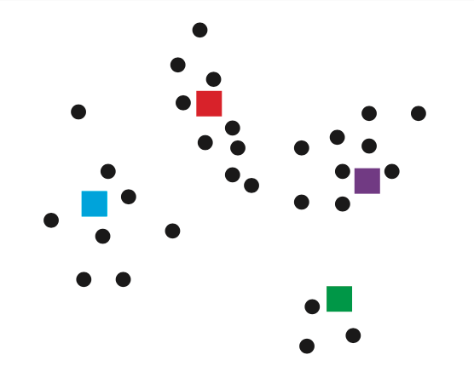
The space of all microbial datasets
Individual microbial samples on SRA
Reference genomes for individual species

Slide 9
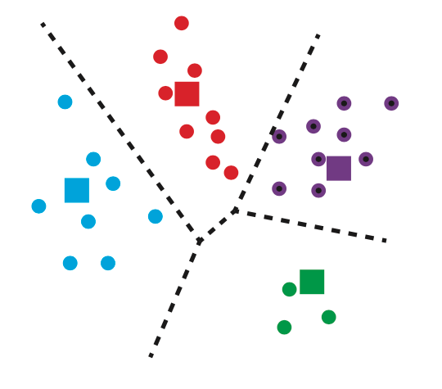
Sample species identification ≈ Voronoi decomposition

Slide 10
Sample species identification ≈ Voronoi decomposition

Slide 11
Trick 2: Hierarchical representation of k-mer data

Slide 12
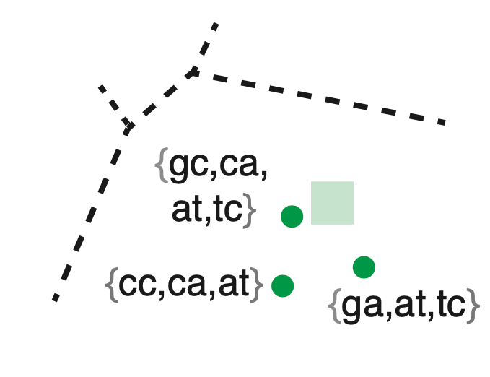
Let’s look at k-mer sets within a single species

Slide 13
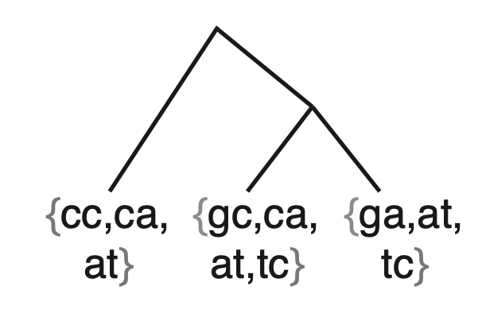
Hierarchical representation of species’ k-mer sets
Mashtree [Katz&al., JOSS, 2019]
- Mash for distance matrix [Ondov&al., Genom Biol, 2016]
- QuickTree for neighbor joining
[Howe&al., Bioinformatics, 2002]
Individual organisms are a result of an evolutionary process
The underlying phylogenetic tree can guide data compression
Tree inference – the main bottleneck (worse than O(n²))
Many k-mer redundancies

Slide 14
K-mer propagation to reorder (simplify) the k-mer data

Slide 15
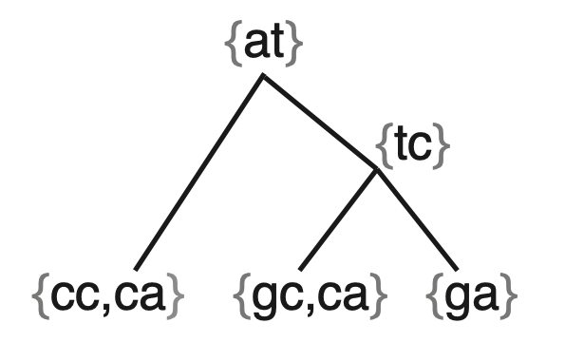
The resulting hierarchy – a lossless repr of the k-mer sets
Most redundancies removed
…but not all of them
#{at,at,tc}
Metric: removed_redundancy =
= 75%
#{at,at,tc,ca}

Slide 16
Trick 3: Simplitigs + xz

Slide 17
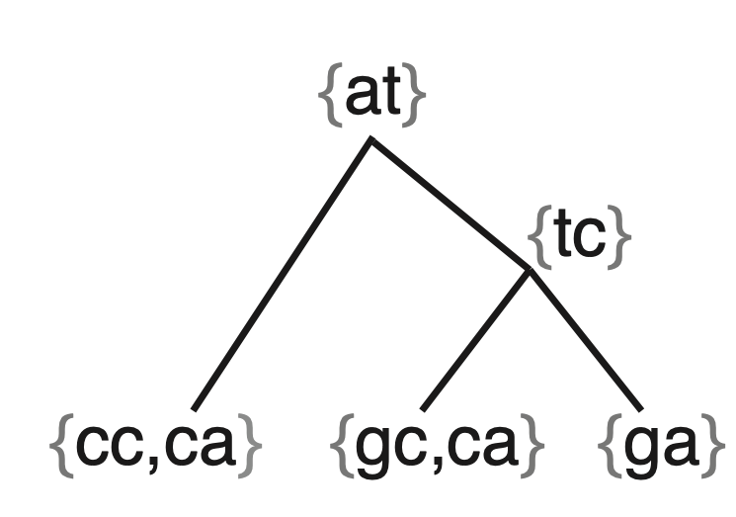
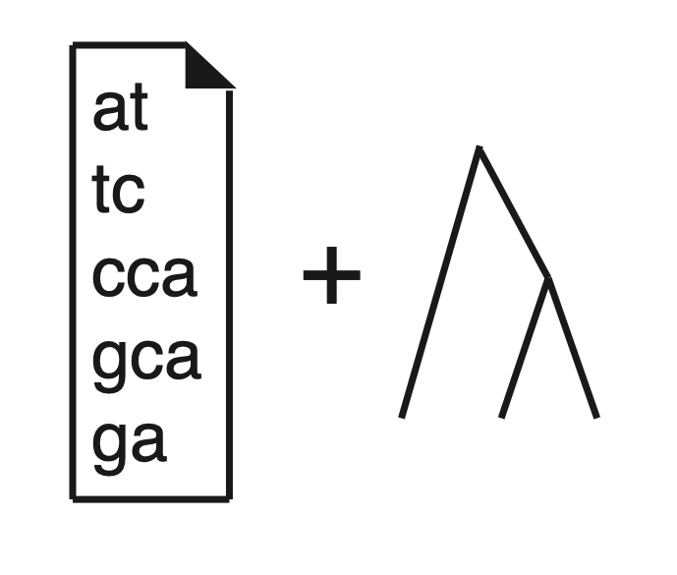
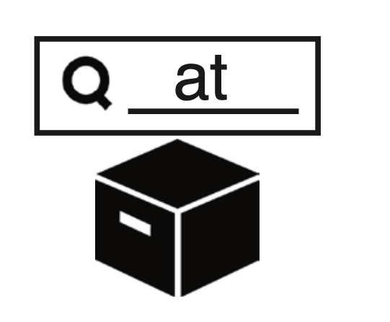
Lempel-Ziv-Markov chain algorithm (xz)
Simplitigs (or spectrum preserving string sets) ~ like unitigs, but more lightweight [B, Baym, Kucherov, Genome Biol., 2021 (in press)] [Rahman, Medvedev, RECOMB 2020]

Slide 18
The overall workflow
Collection of samples (de Bruijn graphs from SRA)
Species clusters
Batches
Hierarchical representations

Slide 19
Results

Slide 20
Huge variability in the data quality
Top 10 most represented species
# k-mers
E. coli
C. jejuni
S. aureus
S. enterica
S. pyogenes
S. pneumoniae
N. meningitidis
M. tuberculosis
K. pneumoniae
L. monocytogenes

Slide 21
Big batches substantially reduced using k-mer propagation
Big batches -> redundancy removal great (>75%)!
Removed k-mer redundancy [%]
If less efficient, on small batches only (therefore, in average not a problem)
Batch size [G k-mers in the multiset union]

Slide 22
Human pathogens are highly compressible
Mycobacterium tuberculosis
Salmonella enterica
Escherichia coli

Slide 23
Compression of a single species (N. gonorrhoeae, n=6,359)
The selected approach
Bits per k-mer
Unitigs
Simplitigs
Propag.
+ simplitigs
Propag.
+ BWT

Slide 24
N. gonorrhoeae distance matrix – high-sim squares
Sorted by the date of submission

Slide 25
Compression of the entire microbial corpus
Number of samples: 425,161
Distinct k-mers: ~41G
Propagation: #k-mers (with multiplicities) reduced from 1,536G to 221G (7-8x less)
The size of the corpus: reduced from ~12 TB (McCortex binary files) to ~75 GB (xz-compressed FASTA files)

Slide 26
Mof – program for downloading and decompression
Like brew, but for de Bruijn graphs from microbial samples on SRA/ENA
$ pip install mof
Examples of usage (download from Zenodo & decompress):
$ mof get ERR1447249 – get a single DBG
$ mof get neisseria_gonorrhoeae__01 – get an entire batch
Downloading and decompressing everything – within approximately 1 night on a decent laptop

Slide 27
Conclusions
First methodology for a lossless compression of truly large collections of de Bruijn graphs
Applied to the complete microbial corpus and compressed from ~12 TB to 75 GB
Can be combined with many existing methods for k-mer indexing
Still work in progress, other updates soon (including comparison to other approaches)

Slide 28
Thank you for your attention!
Simone
Pignotti
Kamil
Salikhov
Rayan Chikhi
Zam Iqbal
Gregory
Kucherov
Michael
Baym

Slide 29
Supplementary slides

Slide 30
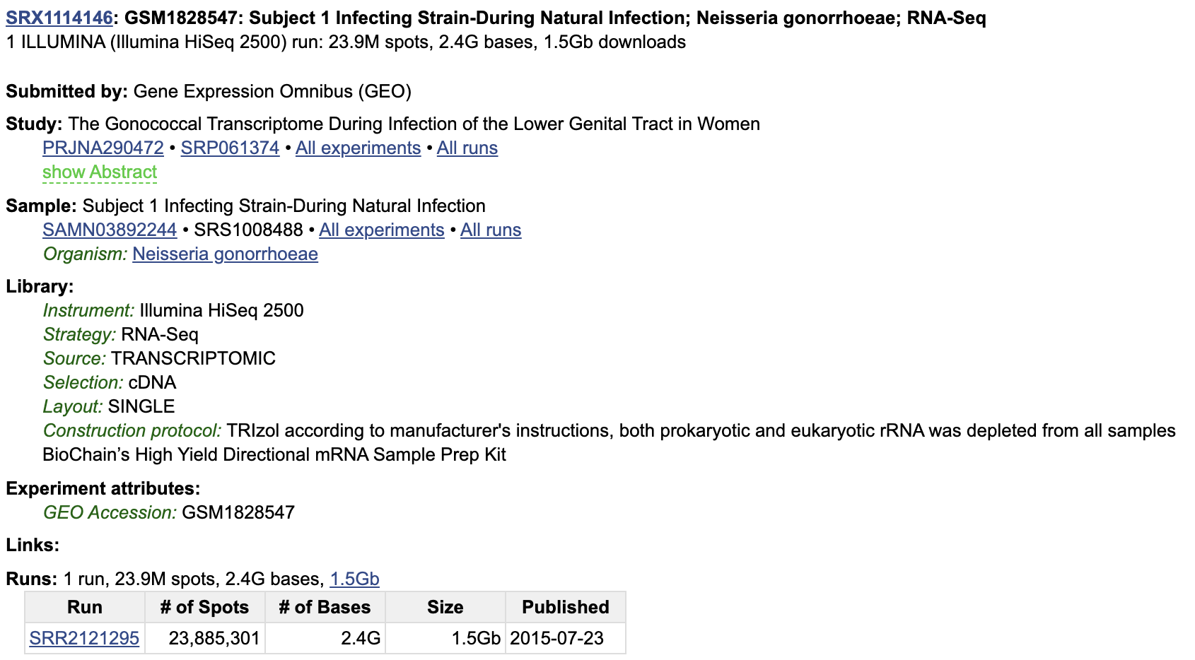
Contamination - examples

Slide 31
Major clusters/species

